Slide 1
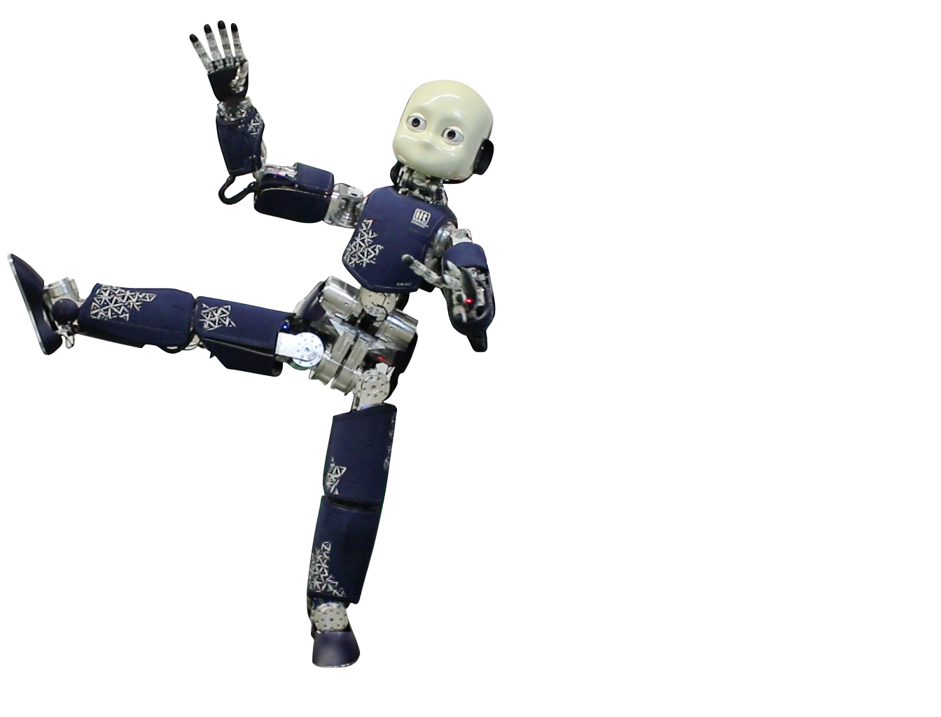
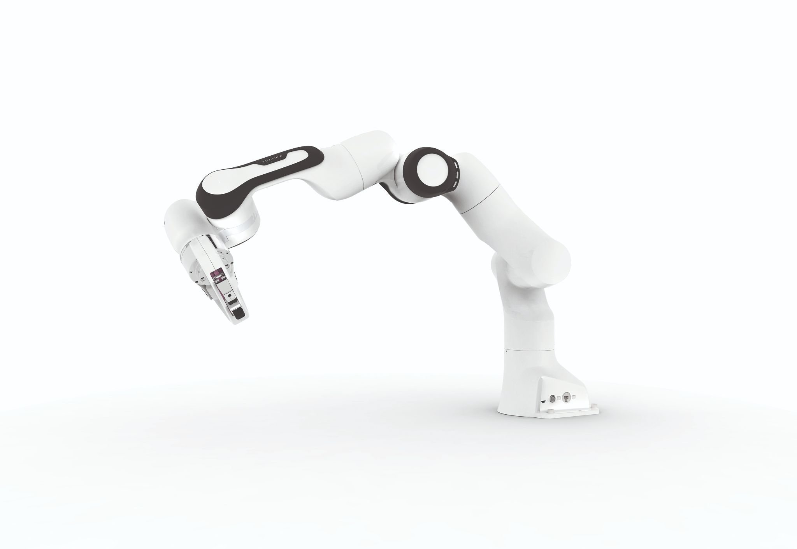
Organization & Grading Applied Machine & Deep Learning (190.015)
Telefon: +43 3842 402 - 1901 Email: teaching@ai-lab.science

Slide 2
Outlook of this lecture
Organization of the 1st week
Dates & Locations
Course Materials & Links
Grading
Some Remarks by Linus Nwankwo, M.Sc.

Slide 3
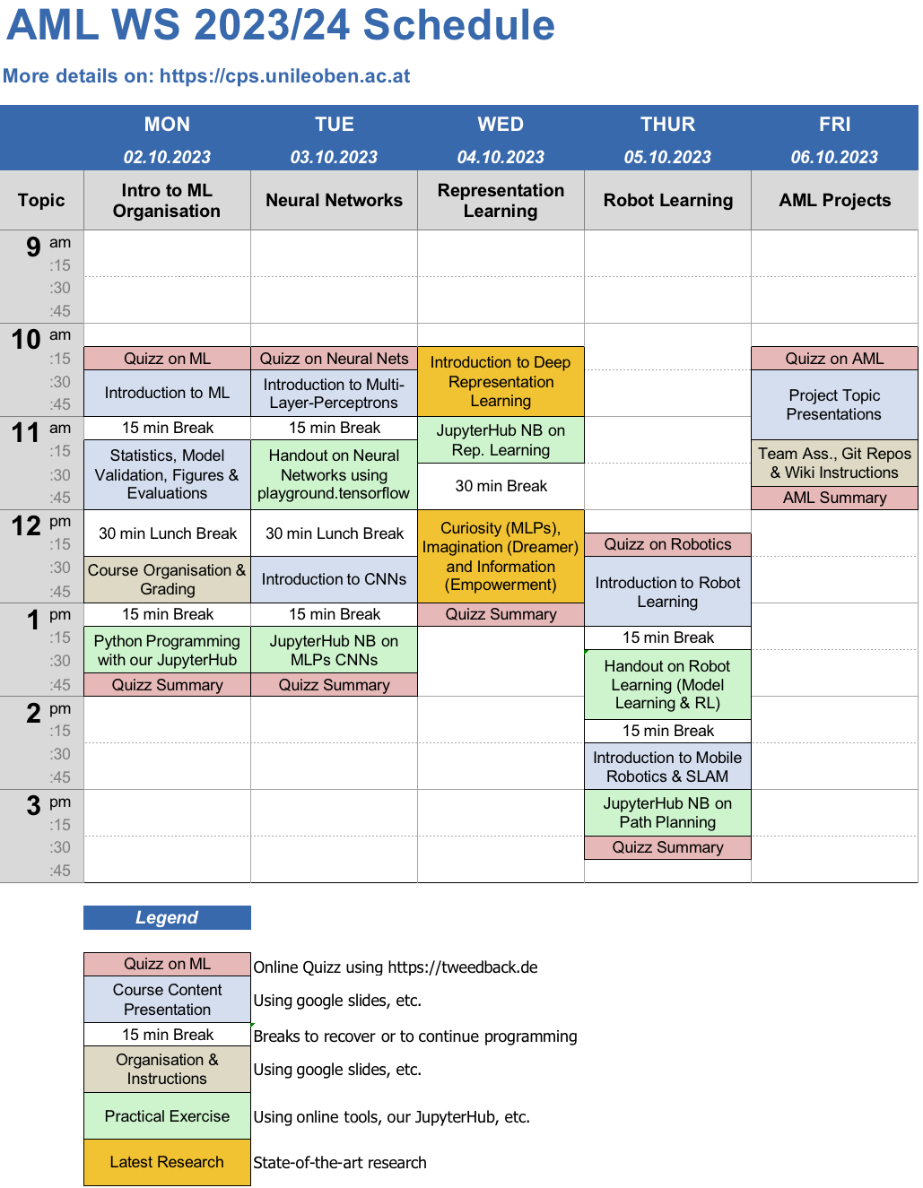
1st Week:

Slide 4
Dates & Locations
Dates: 02.10 – 06.10.2023
Location: HS 3 Studienzentrum, Montanuniversität, Leoben
Recordings of the lectures of of the 1st week will be put on Moodle.
Full link: https://moodle.unileoben.ac.at/course/view.php?id=3082

Slide 5

Dates & Locations
Dates: 07.10 – 31.01.2024
Online Every Wednesday from 17:00 - 18:00 via Webex
Full link: https://unileoben.webex.com/unileoben/j.php?MTID=m5e17e864e5784737dffd2fa1d27d161c
Meeting number (access code): 2789 858 4770
Meeting password: vTHYP5QMj77

Slide 6
Course Materials & Links
Resources:
Everything is linked via course webpage:
https://cps.unileoben.ac.at/190-015-applied-machine-and-deep-learning-5sh-il-ws/
Jupyter Notebooks are hosted on our public git repository: Link will be added here on the 02.10.2023.
Services:
https://jupyter.cps.unileoben.ac.at
https://studgit.cps.unileoben.ac.at (domain not yet activated)

Slide 7
Grading
Project Work
Code* | 0 - 30 pts
Report* | 0 - 40 pts
Final Oral Presentation & Discussion (Dates will be assigned to the teams after the 31st of January 2024). Location is the office of Prof. Rueckert. | 0 - 30 pts
Total | 100 pts
Bonus Points on the Project Work
Excellent Report using wiki repository | 0 - 20 pts
Excellent Algorithmic Implementation | 0 - 20 pts
Active Participation in the 1st Week
Physical attendance | 0 - 10 pts

Slide 8
Grading
Cumulative Points | Final Grade
0 - 49.9 | 5
50 - 65.9 | 4
66 - 79.9 | 3
80 - 91.9 | 2
92 - 100 | 1
A minimum of 50 points need to be achieved to be positive. Git repositories with either not code or no documentation will result in a 5.

Slide 9
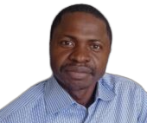
Some Remarks by Linus Nwankwo, M.Sc.
Teaching Assistant of the AML course: Linus Nwankwo, M.Sc.
Short Bio: Mr. Linus Nwankwo started as a PhD student at the Chair of Cyber-Physical-Systems (CPS) in August 2021. Prior to joining CPS, he worked as a research intern at the Department of Electrical and Computer Engineering, Technische Universität Kaiserslautern, Germany.
In 2020, he obtained his M.Sc. degree in Automation and Robotics, a speciality in control for Green Mechatronics (GreeM) at the University of Bourgogne Franche-Comté (UBFC), France. In his M.Sc. thesis, he implemented a stabilisation control for a mobile inverted pendulum robot and investigated the possibility of controlling and stabilising the robot via CANopen communication network.

Slide 10
Notes
Course tutorials and materials will be posted on our JupyterHub.
Online assistance will be limited, therefore, it is encouraged to attend the course in person so that you can get unlimited assistance to enable you finish or at least figure out how to finish the exercise before the due time.
An account will be created for each group in our JupyterHub for submission of the exercise.
The accounts will remain active till the end of the semester.
The final project results will be presented in a written report in form of a git repository wiki page, and presented for a final 5 -10 mins.

Slide 11
Communication and Academic Integrity
Office Hours: If you have any questions or need assistance, please come during the office hour. If you cannot make it to office hours, email me to schedule an appointment.
Emails: It is extremely hard to discuss technical questions through emails. Therefore, we encourage you to come to the lab for such a discussion.
Discussions among teams: Encouraged for a better understanding of course materials. However, each of you (or your team) should work on your code independently after the discussions.
Lab safety: In case your chosen project requires a physical robot or other hardware in our lab, please seek permission from the technician or the person in charge of such hardware.
Citation: Reference any website or academic material used in your project.

Slide 12
Prerequisites
A laptop or tablet.
Internet access. You could use the Uni. internet or eduroam.
Basic Python programming. No worries if you do not have some experience, we will start with the basics.
Basic background in statistics, e.g., probability, descriptive statistics (measures of central tendency and dispersion), visual representation of data (histograms, bar charts, pie charts, scatter plots, etc.).
Recommended Prerequisites: Introduction to Machine Learning (“190.012” and “190.013”).

Slide 13
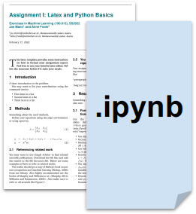
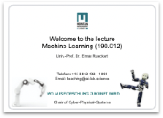
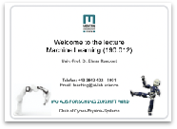

The Project Workflow
Project Presentation
Grouping, Q & A
Reports and Code Submission
Exercise points and grading

Slide 14
Project/Task Presentation
Introduction to the task: 06.10.2023
Motivation & Objectives
Research Questions & Related Work
Problem & Dataset Description
Approach & Methods
Tutorial if required, Q & A

Slide 15
Q & A
During the lecture & office hours
If technical question(s) that involve hardware:
come to the lab
schedule an appointment

Slide 16
Report and Code
Report:
Code:
All reports must be in the Wiki repository or README.md format.
All the code must be written using Jupyter Notebook or Google Colab.
Use our JupyterHub templates at the following repository:
Jupyter Notebook
Just open it and start filling it.
HANDWRITTEN report will not be accepted
Inline comments in the code are necessary, but not mandatory.
The file must be in .ipynb format.

Slide 17
Alternative Submission Method
If there are hitches, or you are unable to work with our JupyterHub, then:
Create a .zip file with the following contents:
.ipynb of your code
.md of the wiki report
Name it m-number_firstname_lastname_task<#>.zip
For example: m123456789_john_smith_assign1.zip
Upload it to the cloud at Direct Upload
Note: No submission will be accepted via email.

Slide 18
PROJECTS OVERVIEW
2

Slide 19
Projects Overview
For the course, we have five (5) projects to be worked on by the students (individual or group):
Application and comparison of deep neural networks for steel quality prediction in continuous casting plants with data from the ‘Stahl- und Walzwerk Marienhütte GmbH Graz’.
Predictive maintenance of bearing shells using frequency analysis in decision trees and deep neural networks based on acoustic measurement data.
Motion analysis and path planning for human-machine interaction in logistics tasks with mobile robots of the Chair of CPS.
Autonomous navigation and mapping with RGB-D cameras of the four-legged robot Unitree Go1 for excavation inspection in mining.

Slide 20
Getting Started Tools
Necessary tools to get started:
Linux: Basic commands are required.
Python: You just need to have a basic idea about data structures, operators, functions, etc.
ROS: ROS Wiki Documentation has all that you need to get started.
Virtual Machines: If your OS is not Linux, do not worry, VMware will work on Windows and Mac.
Git: To better manage your codes, we recommend Git.
Installing and using these tools in your project will be discussed in details in our next lab.

Slide 21
Project Objectives
At the end of this course, you should be able to:
Implement or independently adapt modern machine learning methods, and in particular deep learning methods, in Python.
Analyse data of complex industrial problems, process (filter) the data, and divide it into training- and test data sets such that a meaningful interpretation is possible.
Define criteria and metrics to evaluate, predict, and generate statistical analysis of data.
Develop, evaluate, and discuss meaningful real-world experiments.
Identify and describe assumptions, problems, and ideas for improvement of practical learning problems.

Slide 22
Summary of Organization & Grading
Organization of the 1st week
Dates & Locations
Course Materials & Links
Grading
Some Remarks by Linus Nwankwo, M.Sc.
Resources:
Everything is linked via course webpage:
https://cps.unileoben.ac.at/190-015-applied-machine-and-deep-learning-5sh-il-ws/
Jupyter Notebooks are hosted on our public git repository: Link will be added here on the 02.10.2023.
Services:
https://jupyter.cps.unileoben.ac.at
https://studgit.cps.unileoben.ac.at (domain not yet activated)

Slide 23
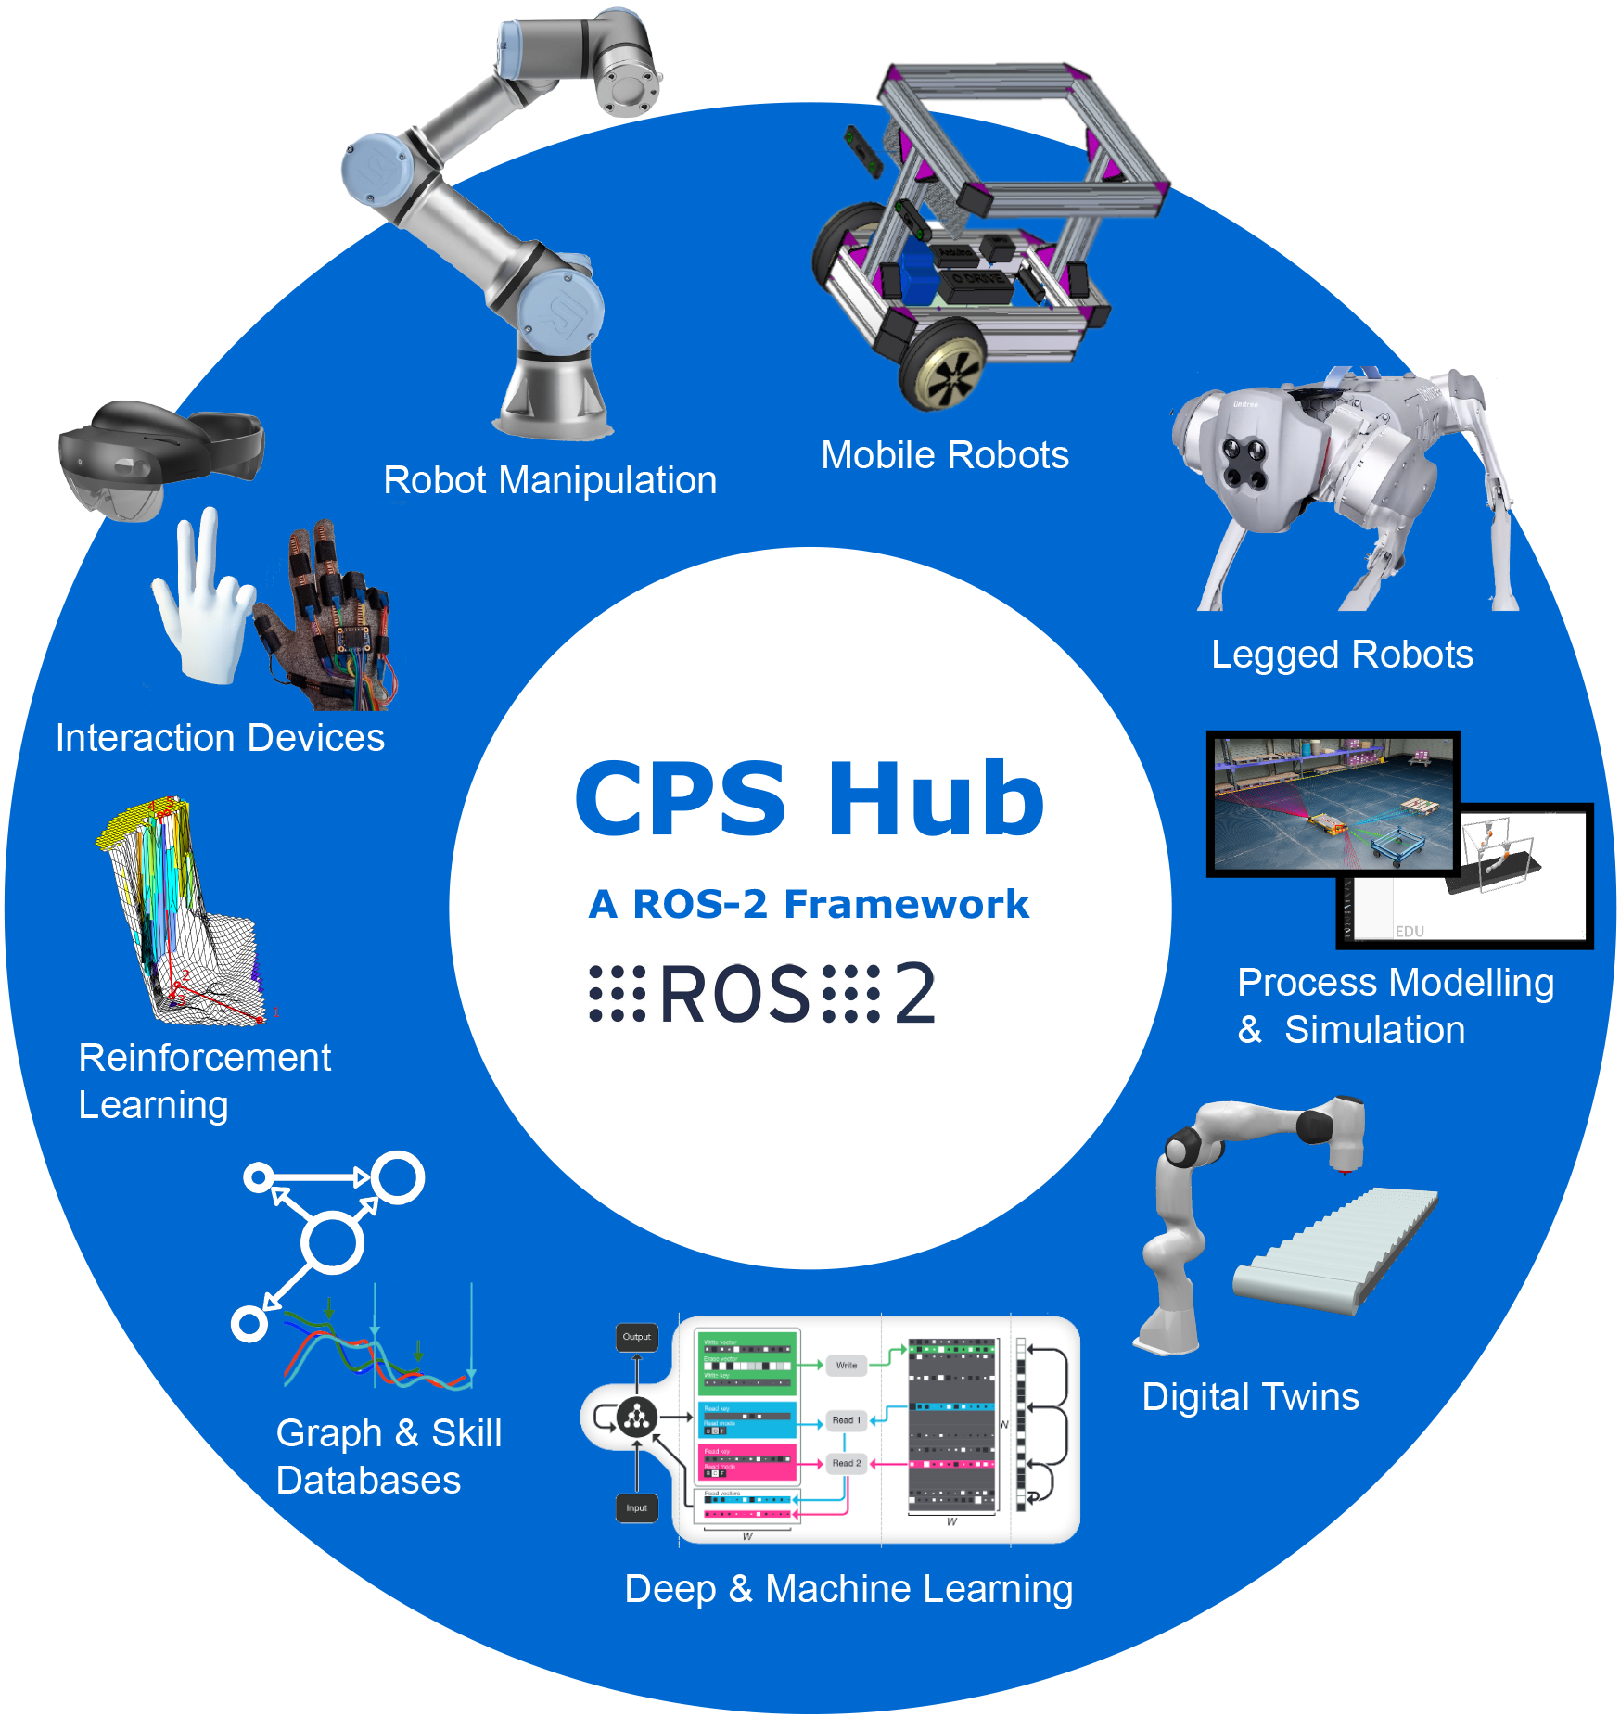

Thank you for your attention!
Visit our Youtube Channel: https://youtube.com/@CPSAustria
Phone: +43 3842 402 – 1901 (Sekretariat CPS)
Email: cps@unileoben.ac.at
Web: https://cps.unileoben.ac.at
Disclaimer: The lecture notes posted on this website are for personal use only. The material is intended for educational purposes only. Reproduction of the material for any purposes other than what is intended is prohibited. The content is to be used for educational and non-commercial purposes only and is not to be changed, altered, or used for any commercial endeavor without the express written permission of Professor Rueckert.

